Slide 1

Alternative Channel to Learn Python when there is no Laptop

Slide 2
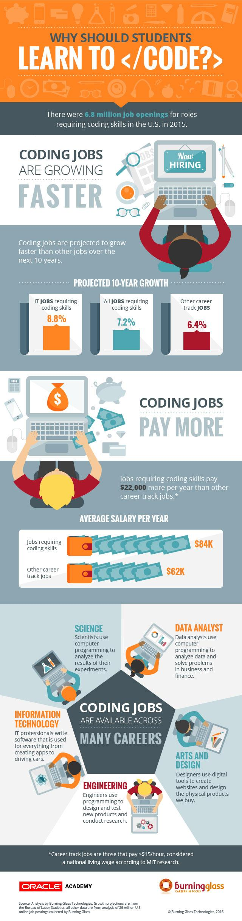
To effectively equip students with the skills of the future:
Teachers must have a working knowledge of these skills
Students must be able to practice what they are taught
...All things being equal
-Source: Burning Glass Technologies
https://www.burning-glass.com/research-project/coding-skills/

Slide 3
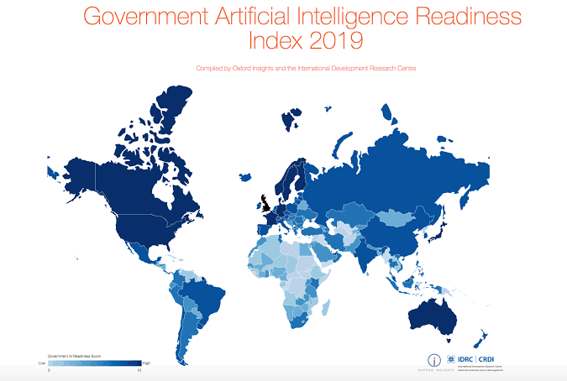
Sadly, all things are not always equal
What we know
Traditional programming is
restricted to the use of
computers (desktop PCs, laptops)
There exists resource
constrained environments
where traditional programming
tools are not available
-Large portion of Nigeria
There is an urgent need for
accelerated learning
-Source: Artificial Intelligence for Development
https://ai4d.ai/more-equal-implementation-needed-to-close-global-inequalities/

Slide 4
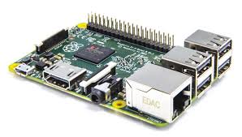
Solution
Microcomputers
These are very small and relatively inexpensive computers with a microprocessor as its CPU. It includes memory and minimal input/output circuitry mounted on a single printed circuit board.
Most common is the Raspberry Pi. A small computer running off a Linux built OS. It’s about the size of your ATM Card and can do everything your computer can- well, almost.
One can get this computer for ₦18000-₦24000

Slide 5
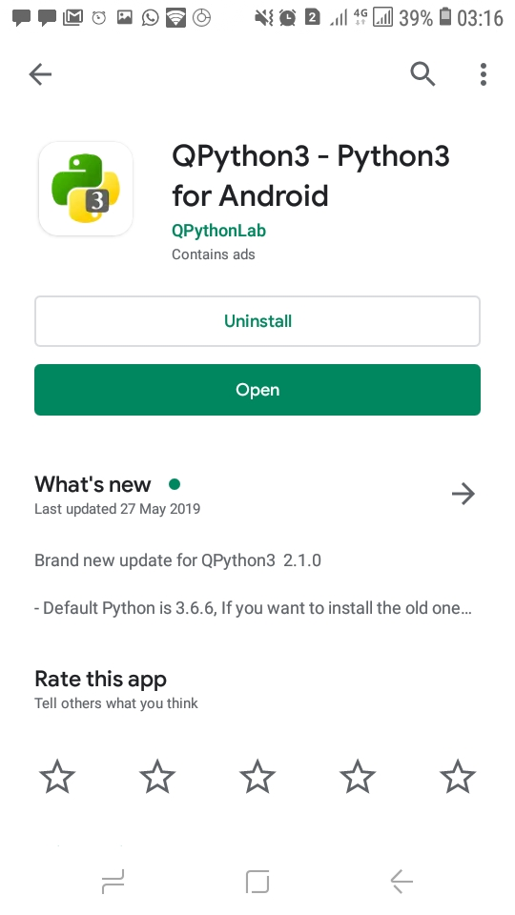
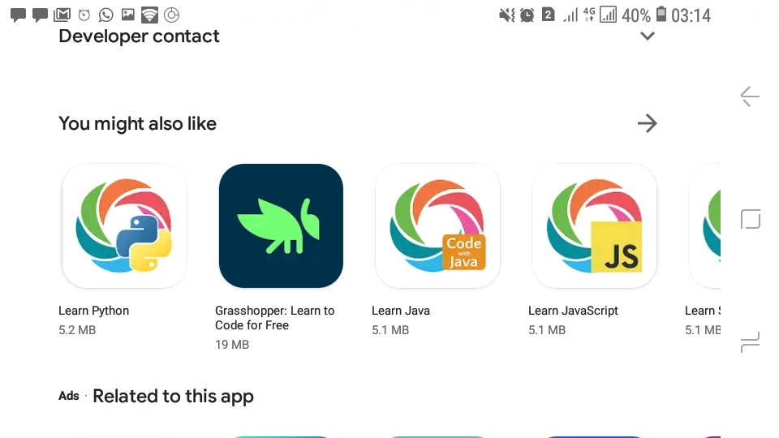
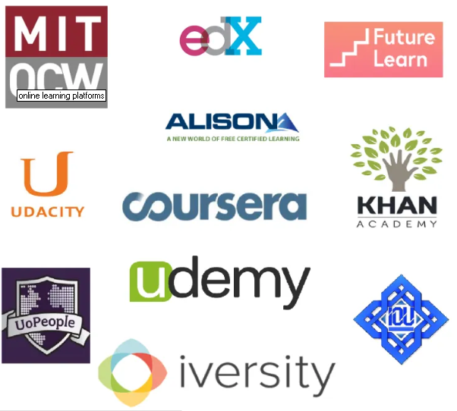
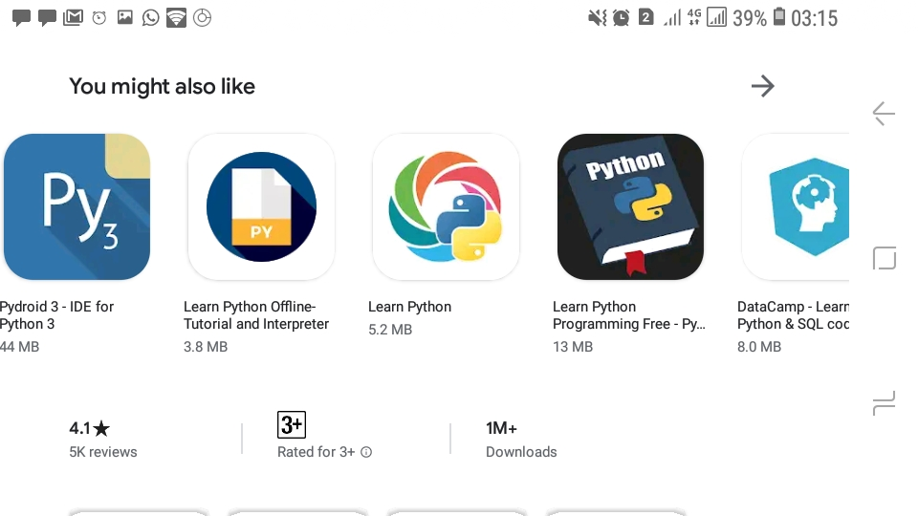
Solution
2. Mobile Device Learning Platforms
Generally, these are phone-based applications that offer learning services
In terms of learning Python, they have built in script editors and interpreters that enables one to write and execute Python codes on mobile devices
Available in free and paid versions
Android and iOS versions

Slide 6
QPython 3
QPython3 is a port of Python3 for android
An android application that allows users to learn, program and run Python3 applications on android devices.
Similar applications are available for ios
Play Store Link: https://play.google.com/store/apps/details?id=org.qpython.qpy3&hl=en

Slide 7
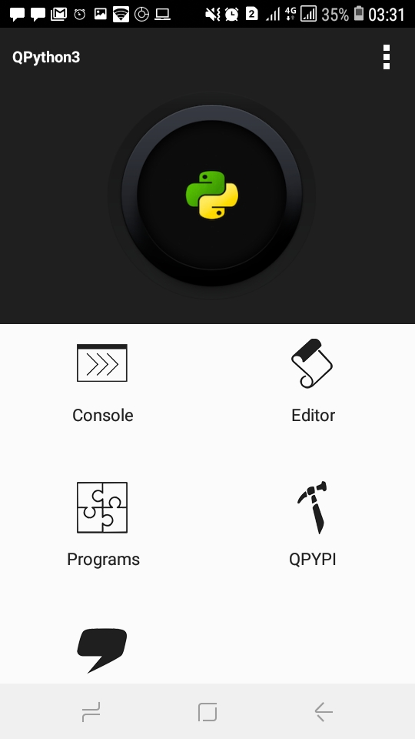
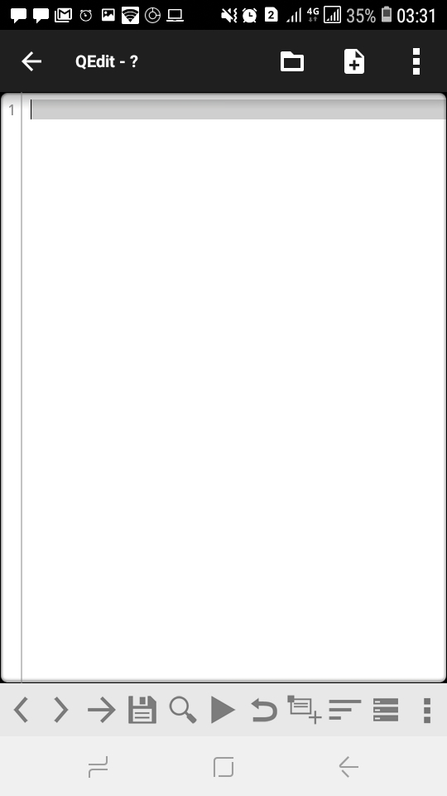
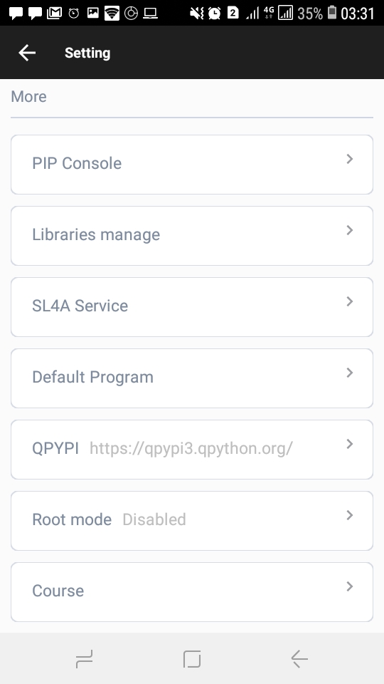
Using QPython 3

Slide 8
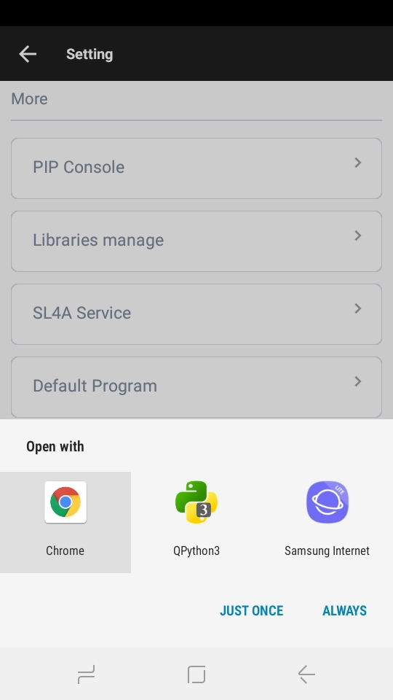
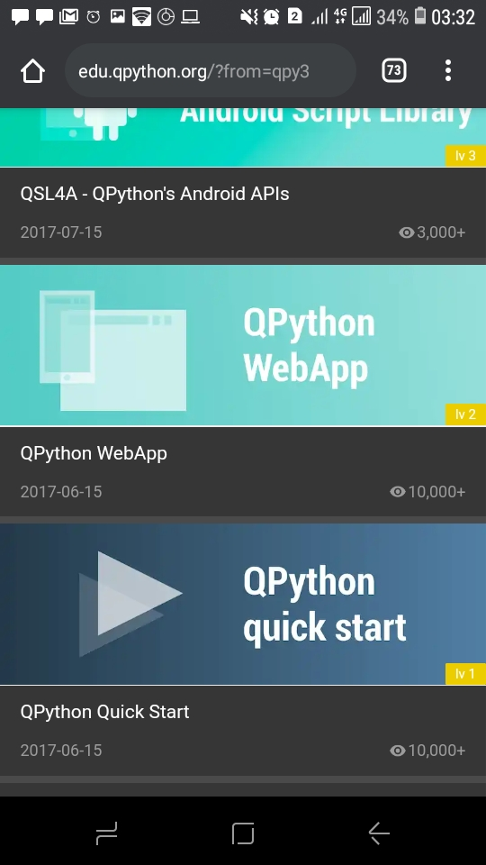
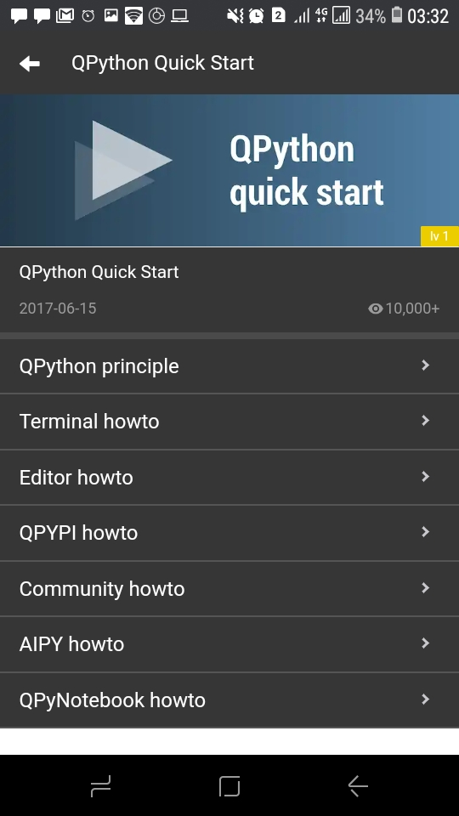
Using QPython 3

Slide 9
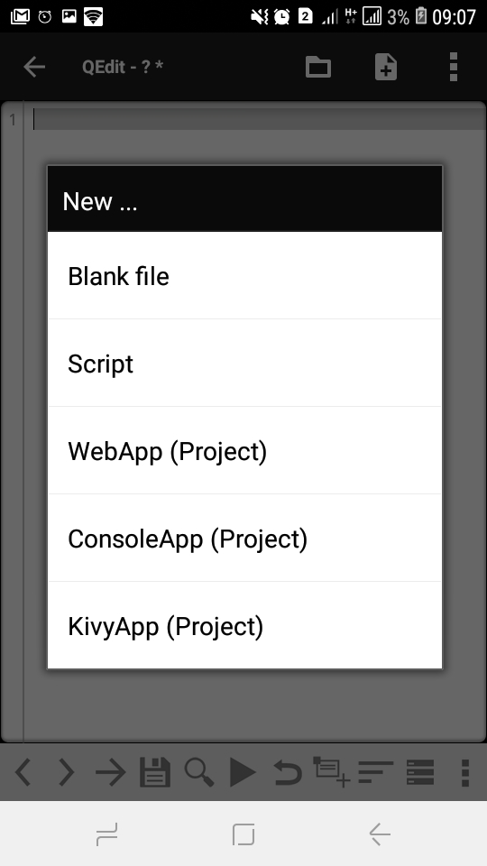
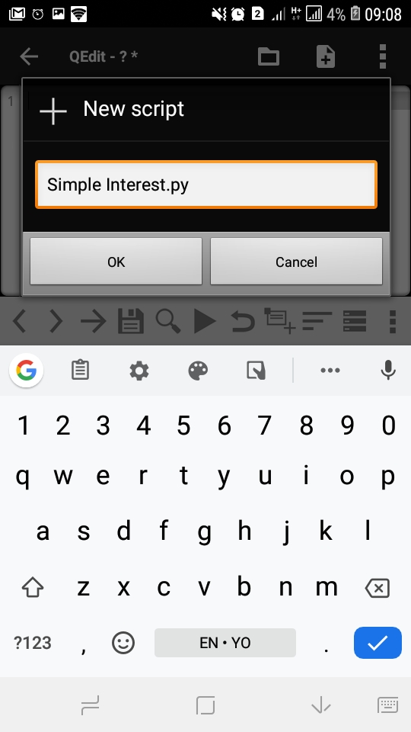
Example: Simple Interest
We will use QPython 3 to write a program that calculates simple interest

Slide 10
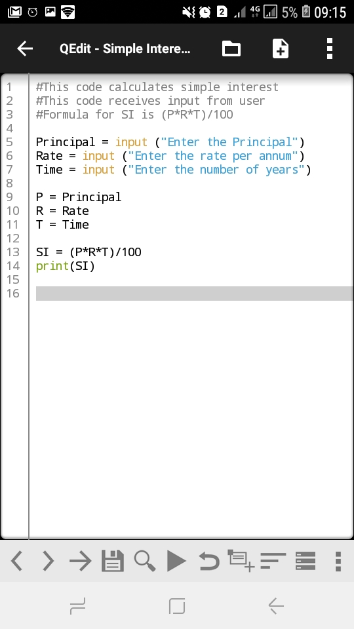
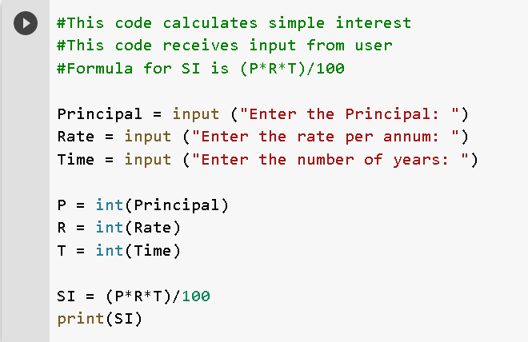
Example

Slide 11
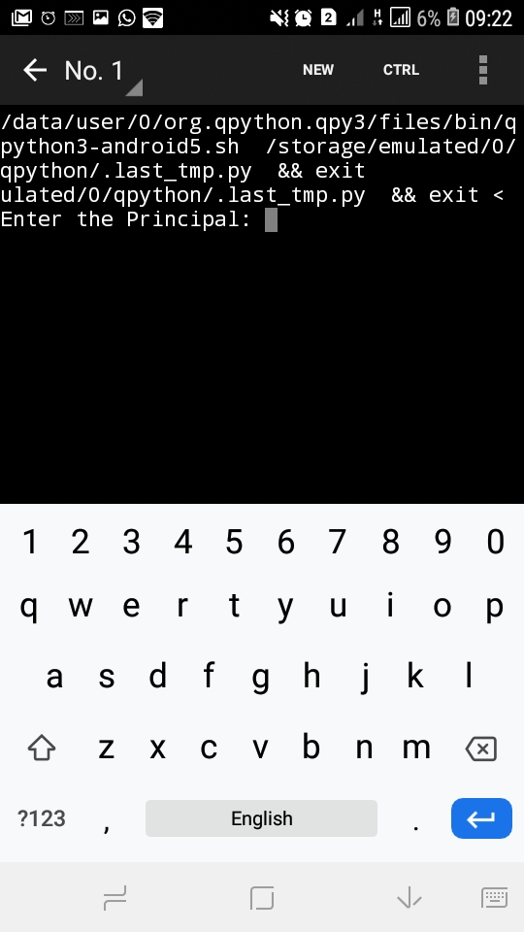
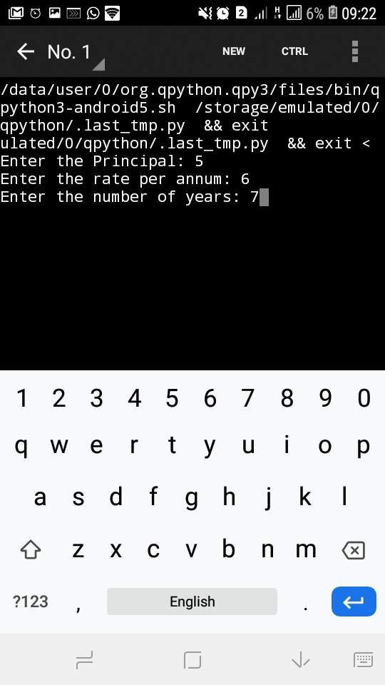
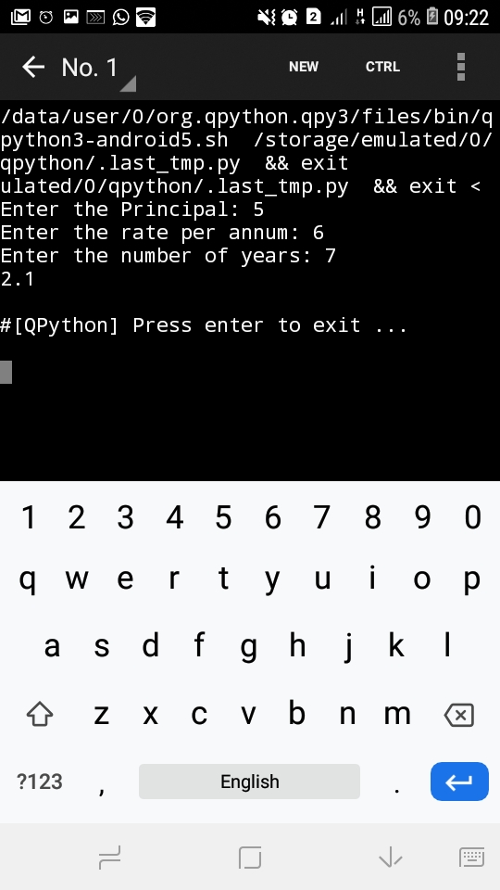
Example

Slide 12


